Slide 1
Numerical Computation Lec 4
By
Asst. Prof. Syed Shujaat Hussain

Slide 2
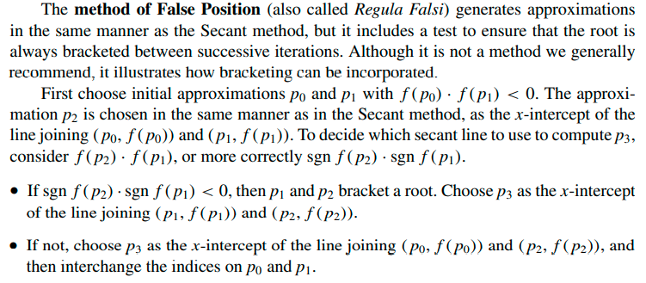
The Method of False Position

Slide 3
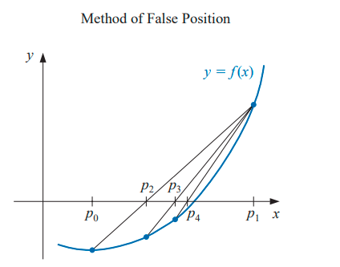

Slide 4
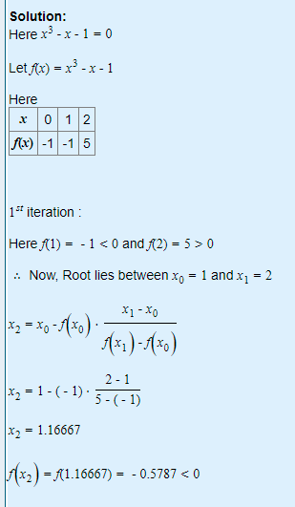
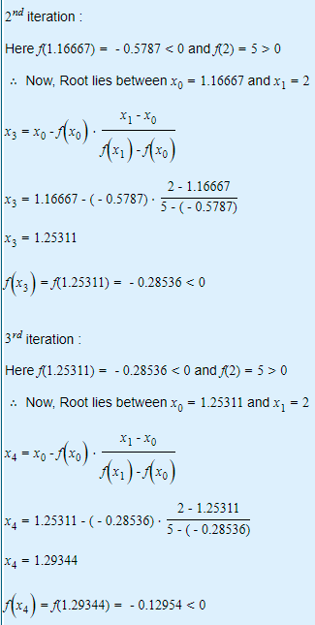
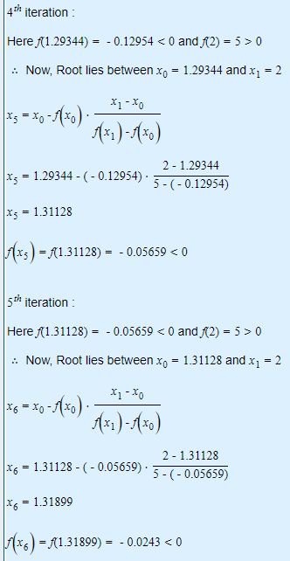
Example: Find a root of an equation f(x)=x³-x-1 using False Position method

Slide 5
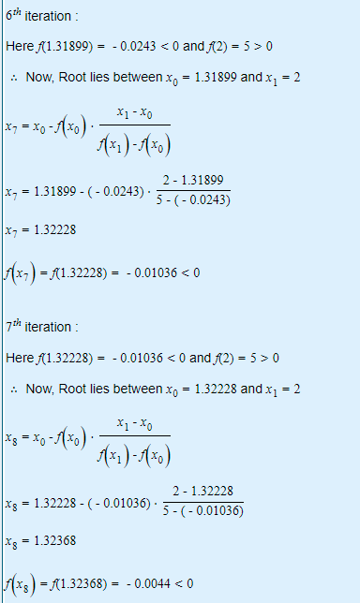
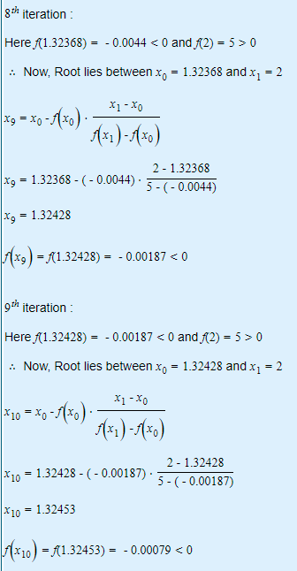
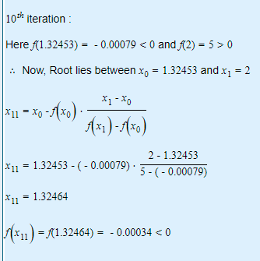
Iteration Continue..

Slide 6
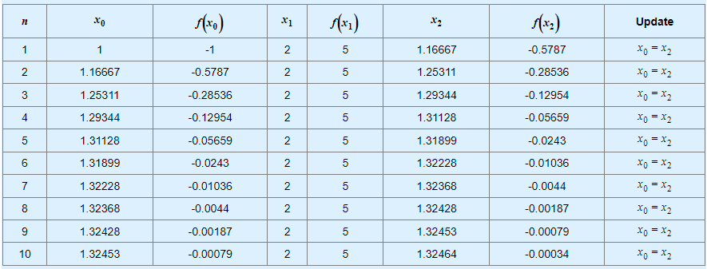
Iteration Table

Slide 7
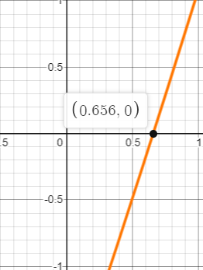
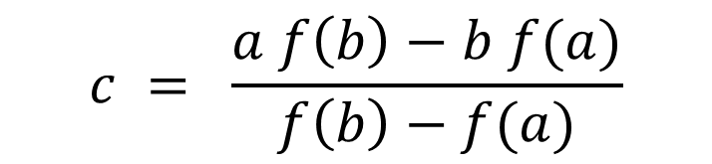

Class Activity Q Find a root of f(x)=2x-cosx-e^{-x} using False Position method
x | f(x)
0 | -2
1.5 | 2.7061326
$$c = \frac{a f\left(b\right)−b f(a)}{f\left(b\right)−f(a)}$$
$$x2 = \frac{x0f\left(x1\right)−x1f(x0)}{f\left(x1\right)−f(x0)}$$

Slide 8
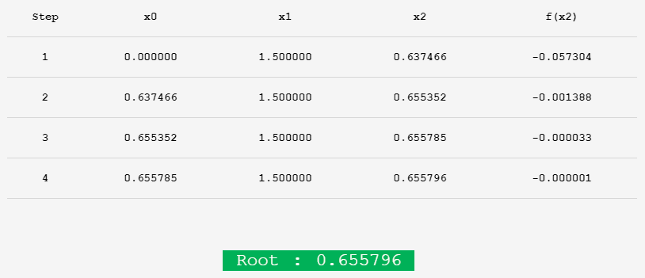
Solution

Slide 9

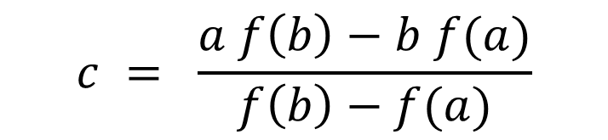
Class Activity Q Find a root of f(x)=x³-cosx using False Position method
x | f(x)
0 | -1
1 | 0.459697
$$c = \frac{a f\left(b\right)−b f(a)}{f\left(b\right)−f(a)}$$
$$x2 = \frac{x0f\left(x1\right)−x1f(x0)}{f\left(x1\right)−f(x0)}$$

Slide 10
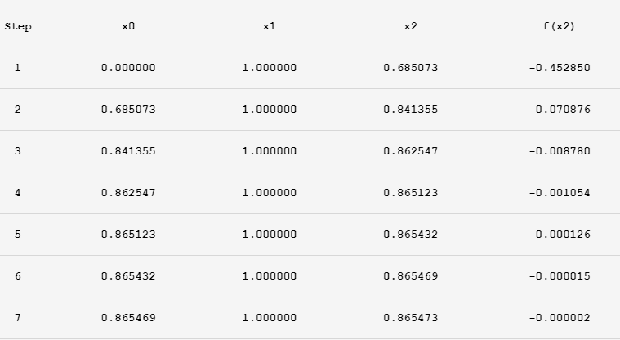
Solution

Slide 11

Test your ability!
Q : Use method of false position for finding the value of take x₀=2 and x₁=3.

Slide 12
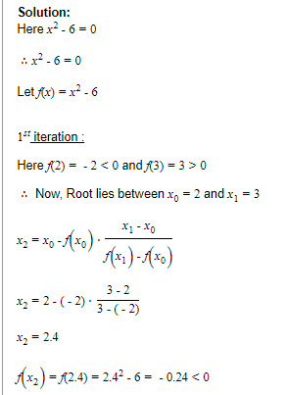
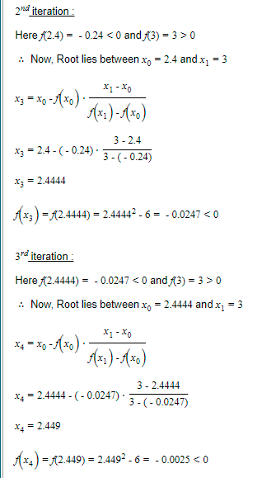
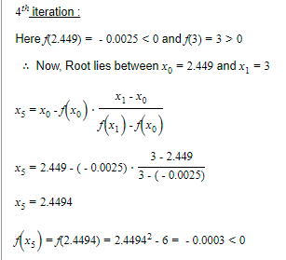
Solution

Slide 13
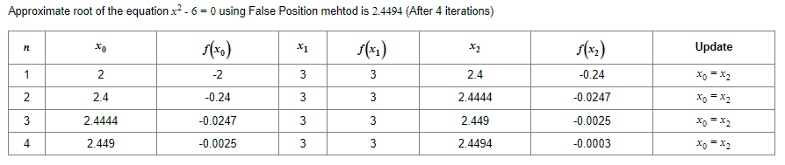
Solution

Slide 14
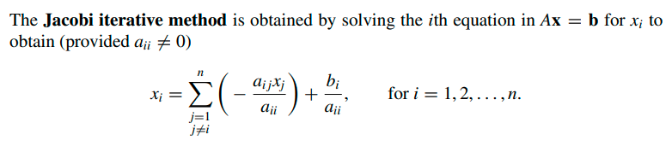
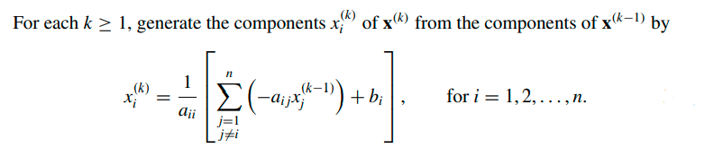
Solution of Linear Systems AX=B
Jacobi’s Method

Slide 15
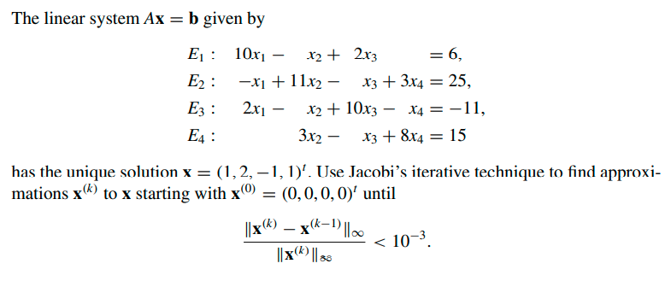
Example

Slide 16
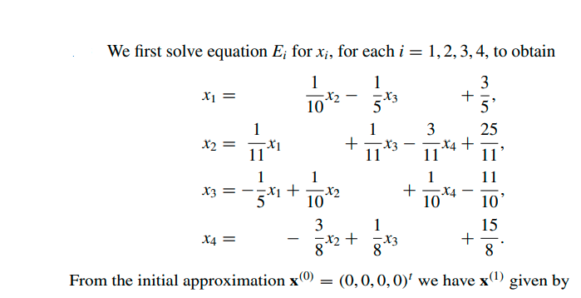
Solution

Slide 17
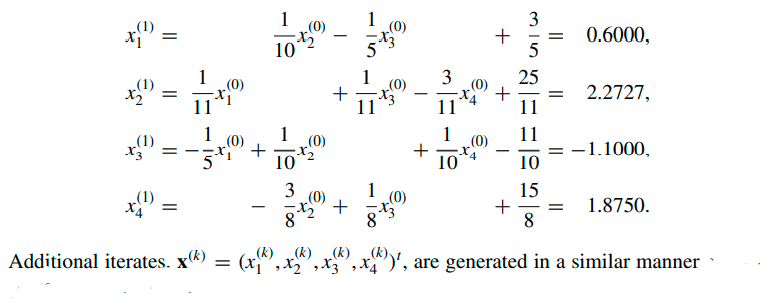
Continue..

Slide 18
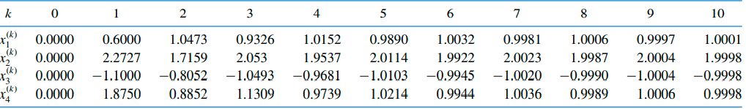
Iteration table

Slide 19
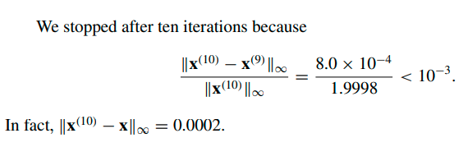
Stopping criteria

Slide 20
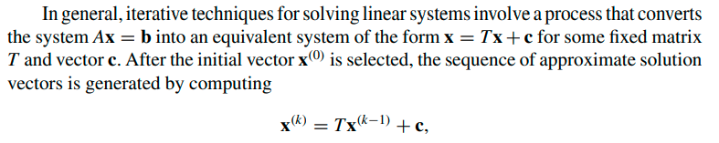
Jacobi Process of iteration

Slide 21
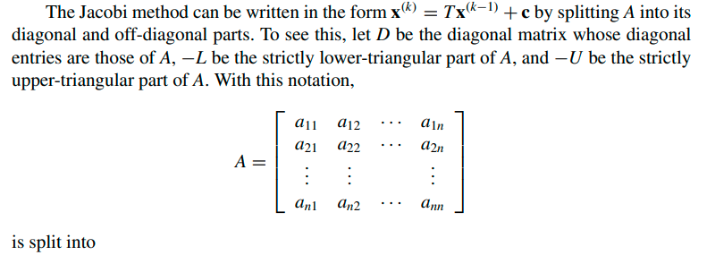
Continue..

Slide 22
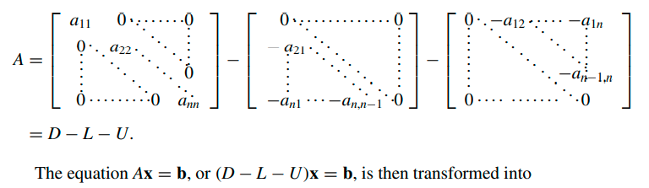
Continue..

Slide 23
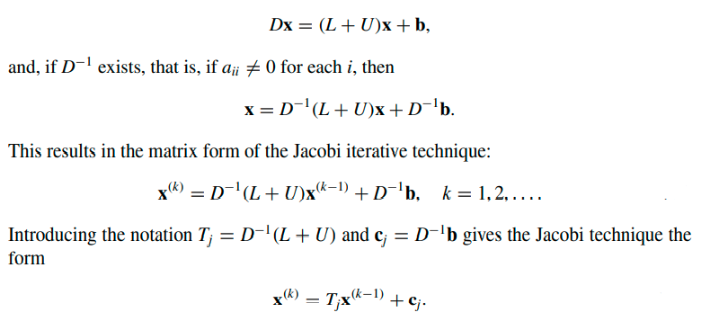
Continue..

Slide 24
Gauss Jacobi Method
Q Solve system of Equation using Gauss Jacobi method
3x - y + z = 1
3x + 6y + 2z = 0
3x + 3y + 7z = 4

Slide 25
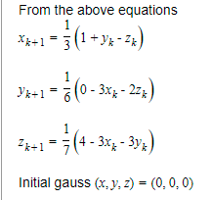
Solution

Slide 26
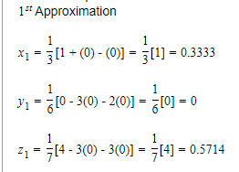
Solution

Slide 27
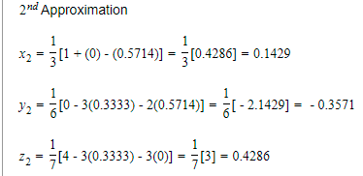
Solution

Slide 28
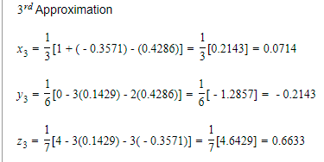
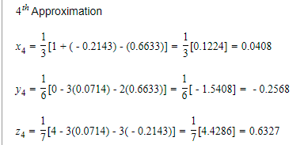
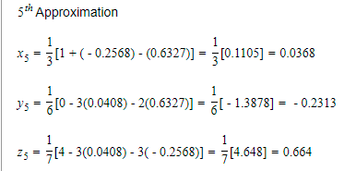
Iteration Cont..

Slide 29
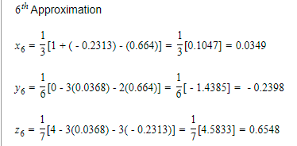
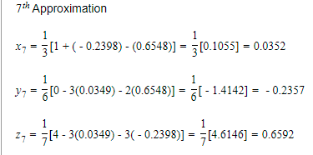
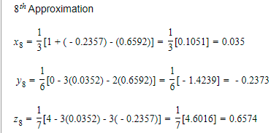
Iteration Cont..

Slide 30
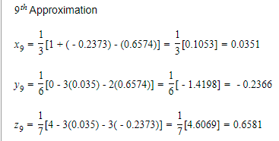
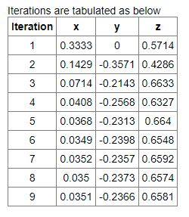
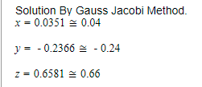
Result

Slide 31
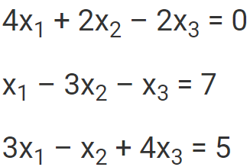
Class Activity
Q. Solve the following system of linear equation by iterative Jacobi Method.
( Perform 10 iterations)

Slide 32
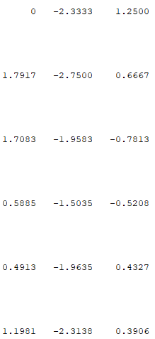
Iterations
X1 X2 X3 X1 X2 X3 X1 X2 X3
1 7.
2 8.
3 9.
4 10.
5 11.
6 12.

Slide 33
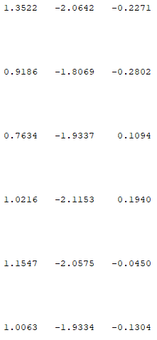
Iterations
X1 X2 X3 X1 X2 X3 X1 X2 X3
1 7. After 47 iterations
2 8.
3 9.
4 10.
5 11.
6 12.

Slide 34
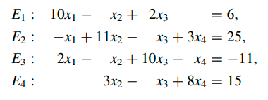
Test Your ability! Q: Solve system of equation by Jacobi’s Method

Slide 35
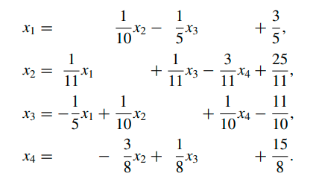
Solution

Slide 36
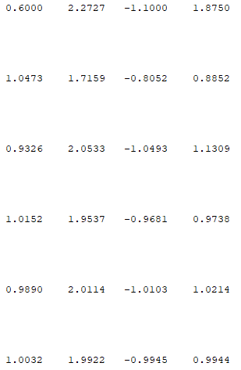
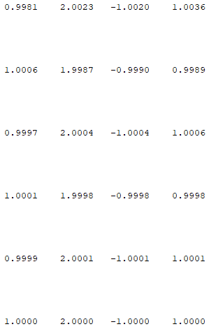
Iterations
X1 X2 X3 X4 X1 X2 X3 X4
1 7.
2 8.
3 9.
4 10.
5 11.
6 12.

